Slide 1

Findings from the European Mobile Metrics Report
September 2010 Mobile Monday Global Summit

Slide 2

Company Overview
Founded in 2003, privately held, VC funded (Motorola Ventures and France Telecom)
150 employees worldwide, with operations in California (HQ), Tucson, New York, London, Paris, Munich, Madrid, Milan, Brazil, and Toronto
Products and services for development, testing, and quality assurance of mobile applications
Flagship product, DeviceAnywhere Test Center™
Notes:
2

Slide 3

Industry Challenges in Summary
Regardless of the product or service– Mobile Application Testing is imperative: Test early, test often, test on the actual device.
The Challenge
Mobile device, OS, network and platform fragmentation
Offshore locations/disparate teams
No easy way to communicate device/application issues during development/testing phase
The Solution: DeviceAnywhere Test Center™ – 24x7 remote access to 2000+ mobile devices connected 30 worldwide carrier networks across U.S. Europe, Canada and Latin America.
Test any mobile application, content, or website on the device
Reporting and collaboration features
On-demand online access means no need to purchase devices or service plans
SaaS solution with a no-contract monthly subscription and usage based pricing model
Notes:
So when it comes to challenges of mobile application development – regardless of what the application is testing is a necessity. Ultimately you are responsible
For the quality, uptime and functionality of the app. So whether you build the app from scratch or if a vendor does it for you, it needs to work across all platforms networks and devices you plan to offer it on. Some of you may be familiar with the mantra common among app developers: “Test early, test often, test on the actual device. “ – well they weren’t kidding!
[Bullets: The Challenge]
I mentioned fragmentation and we will discuss it more but another issue that our users often have to deal with is offshore locations. Large communities of developers are spread across different countries/cities etc. So for if I need to communicate a glitch or an error I need to record it and e-mail it every time or call someone or set up a Webex to go through it. Not the most efficient way to communicate what may turn out to be a large number of glitches.
Our solutions have been specifically designed to address these challenges.
Test Center –
24x7 remote access to over 2000 devices connected to over 30 worldwide carrier networks across U.S. Europe, Canada, Asia.
Test any mobile application, content, or website
Reporting and collaboration features
On-demand online access means no need to purchase devices or service plans
SaaS solution with a no-contract monthly subscription and usage based pricing model
Test Automation
Easily create simple or complex test scripts to test any mobile application, website, or content
Test automation allows for scheduled tests to run at the tester’s convenience
Convenient web-based reporting interface records all results and can be accessed remotely
Scripts can be utilized across multiple handset models
Proof Center
Document all proof of your work
Streamline the approval process
Lower costs of submission

Slide 4
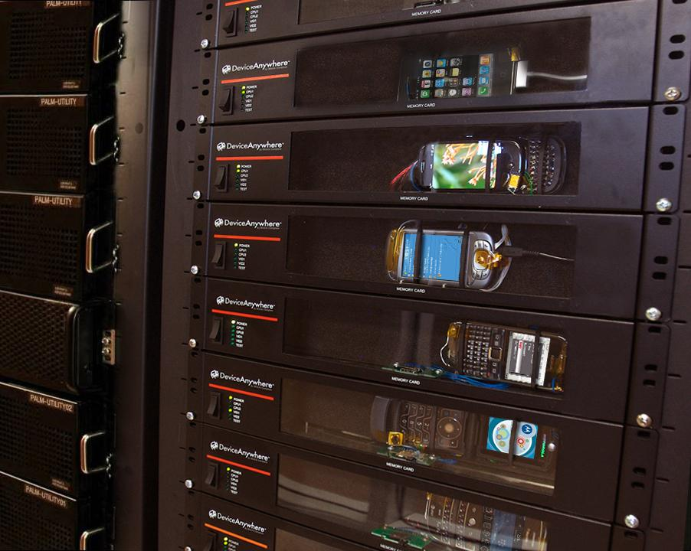
How it Works

Slide 5
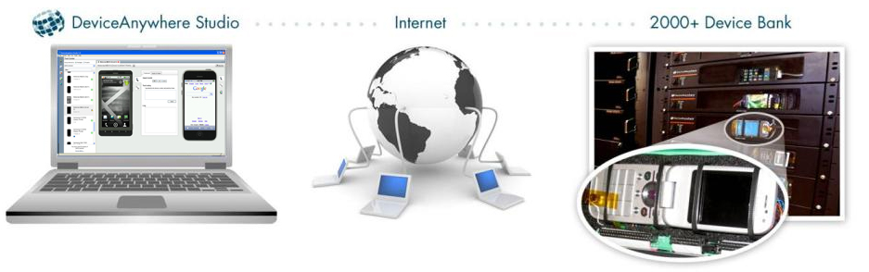
Direct-To-Device™ Technology
Direct connections to every device input and output allowing for full device functionality; as if the device were in your hand:
Pressing buttons
Opening and closing flip phones, tapping touch screens,
connecting/disconnecting the battery, accelerometer support
View the LCD with accurate pixel-by-pixel displays
Listen to ringers and speakers
Notes:
5
Further in the Direct-to-Device model… as indicated before you are interacting with a real device in real time and accessing the devices through DeviceAnywhere Studio. Electrical connections provide comprehensive support for all hardware functions of the device enabling the tester to do anything that their end-user can do on the device including: touch screen: multi-tap, pinching, swiping, accelerometer, mute, power on/off, clamshell open/close, backlights, vibration, volume increase, hardware compass, camera.
The LCD display is also an important piece especially when comes to testing. Other options in the market such as emulation or software only approaches will not give you the accurate LCD pixel-by-pixel displays. So when it comes to ensuring a high quality experience this is important.

Slide 6
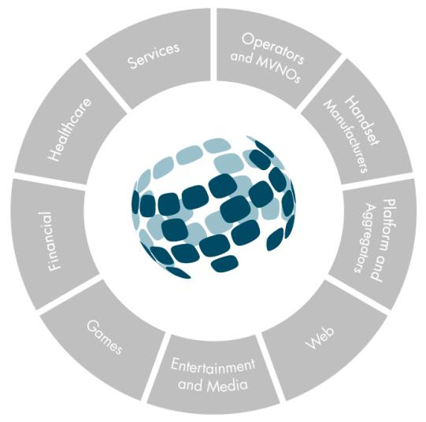
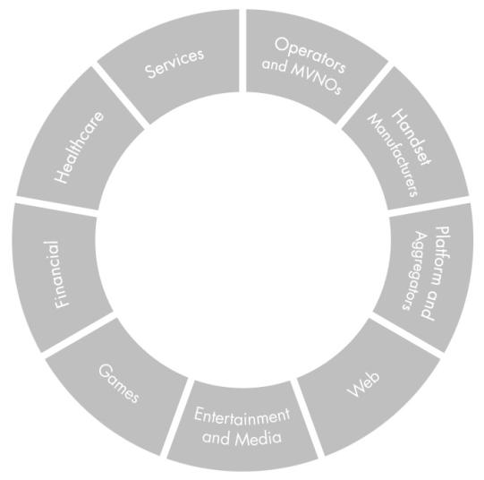
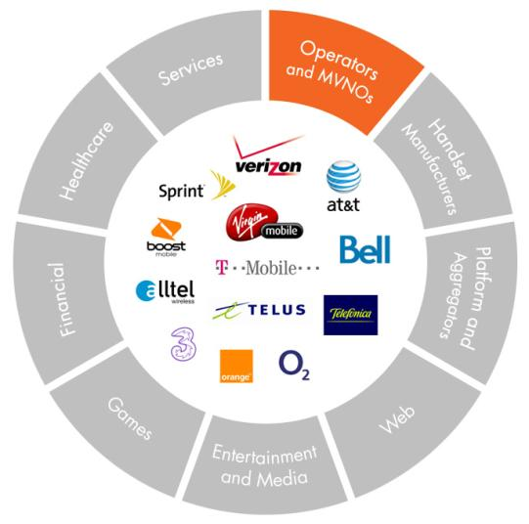
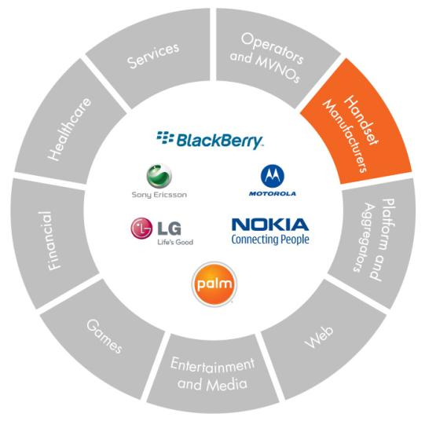
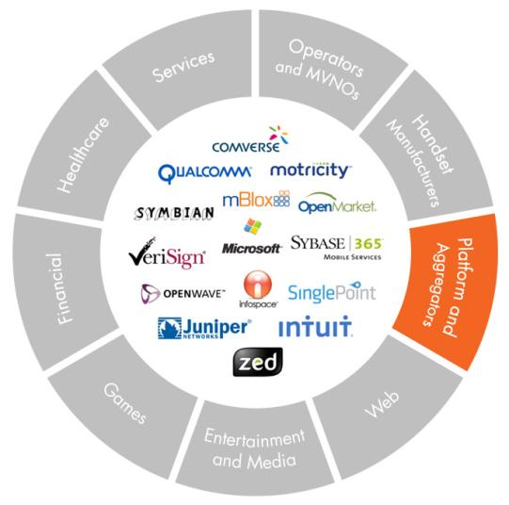
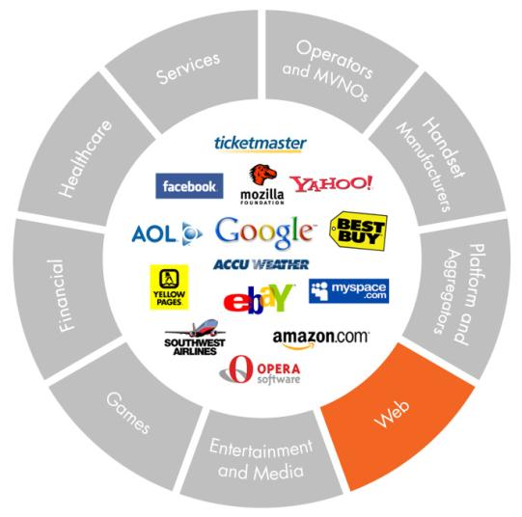
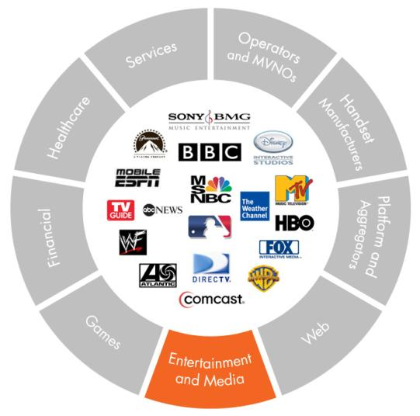
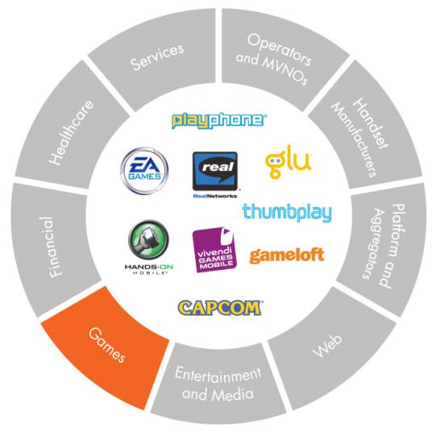
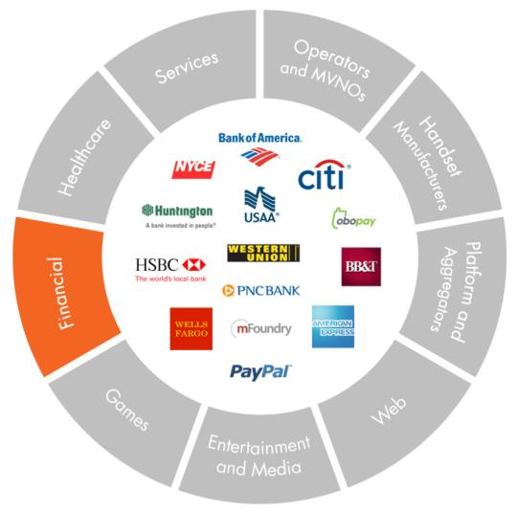
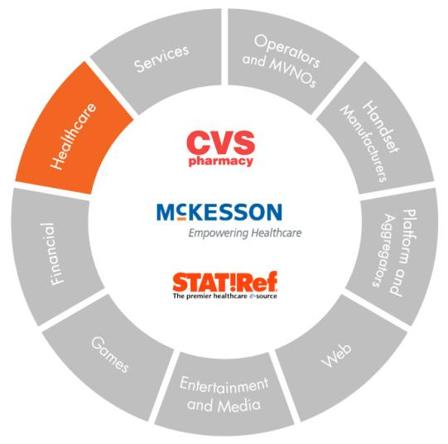
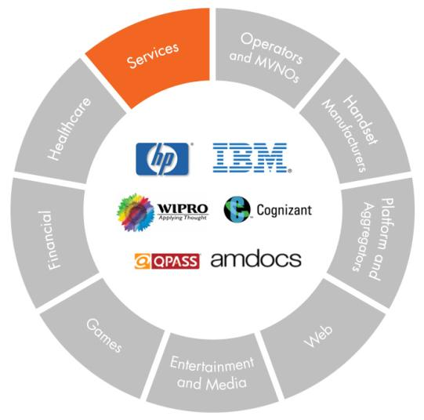
Test Center™ Customer Ecosystem
Notes:
Our service caters to numerous entities across the globe and this view is particularly interesting [start with Operators] … what we are seeing here is the whole ecosystem.
The operators and MVNO’s who all have a vested interest in ensuring the successful app development and adoption… [move onto OEMs and rest] handset manufacturers who are also tasked with application quality both at the hardware and software level, Aggregators and of course the whole spectrum of organizations across the web. But it doesn’t stop there. Now we are seeing a larger constituency of players across the vertical markets adopting mobile to either bring existing products or launch new products exclusively on the mobile platform. [Entertainment and Media] The priorities on what is most important vary. In Entertainment and media it calls for a rich end-user experience [Games] Gaming companies need speed, time to response and click rates are a priority for them. [Financial] and Healthcare are two areas where the mobile handset is catering to both front end consumer level and back end enterprise needs. So accessing your account information and transferring funds at the consumer level to using CRM tools to communicate with your staff at an IT level. Quality and reliability are key in these cases. So while the priorities vary the common understanding is that it needs to work across all the devices and platforms and networks and OS’s available in the market…. That’s the challenge that we will discuss today

Slide 7
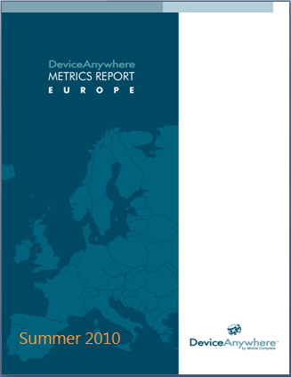
Introducing DeviceAnywhere Metrics Report
WHAT IS THE METRICS REPORT?
Aggregation of real data about how developers are spending their development time and sharing it with the market
4 major EU markets: UK, Germany, France, Spain
Taken from DeviceAnywhere’s customer base of more than 10,000 active users.
Differs from the traditional market snapshots that compare usage trends and sales in mobile. It comes from people testing applications.
First European report, following successful launch of US data in December 2009
Compare the characteristics/trends/preferences of our customers in Europe and those with the US, in terms of OS, manufacturers and phone types.
Goal: To help inform on mobile trends
Notes:
7
This is the first European metrics report we have done. We’re releasing it publicly at the end of the month, but thought it would be fun to provide you a sneak peak into some of our findings.
This report differs from the traditional market snapshots that compare usage trends in mobile. It comes from developers. Our customers, you people out there, are shaping the mobile industry.
Another exciting element about this report was that it is the first time that we have been able to compare the characteristics/trends/preferences of our customers in Europe and those with the US, in terms of OS, manufacturers and phone types. It was interesting to see some of the differences.
Before we delve into the numbers I would like to clarify that this report contains handset usage stats based on usage in the DeviceAnywhere Test Center (Saas) service on devices offered in four major EU markets (Germany, France, Spain and UK). This report is published to the mobile community to help inform on mobile trends related to handsets and application development. We don’t monetize this report and would be happy to discuss methodology but suffice it to say that this data is not necessarily representative of the popularity of various device models, or the number of applications developed for various handset models or platforms. Numbers may be impacted by the availability of certain device models within the DeviceAnywhere system.

Slide 8
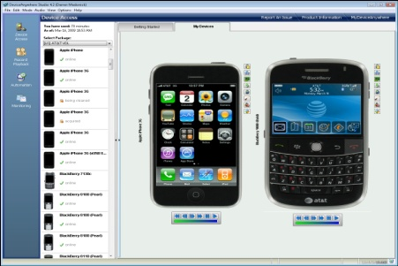

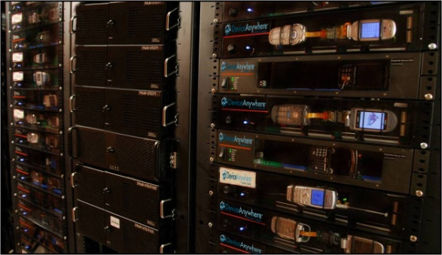

Source of metrics data
DeviceAnywhere
Test Center
2000+ Device Bank
Internet
Approx 400 unique EU Devices included in EU Metrics
Usage numbers based exclusively on Test Center Service
“Usage” includes app testing for both consumer facing and enterprise apps
Over 350,000 hours were logged in DeviceAnywhere service in 2009
Data is aggregated once a month both in the US and EU and analyzed on a quarterly basis
So lets dive in….
Notes:
8
The source of the metrics data comes from the usage numbers on our service

Slide 9
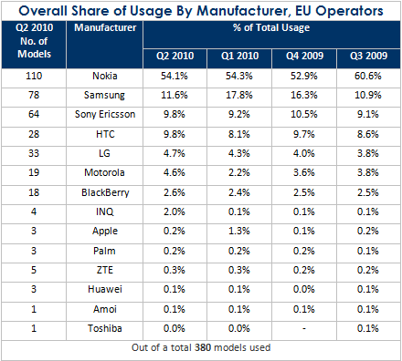
Most Popular Device Manufacturers
European developers spend most of their time testing for Nokia. Surprise!
Notes:
When we look at where the developers are spending their time when it comes to manufacturers Nokia is totally dominant with 54% of developer time
But down from nearly 61% in Q3 2009
Samsung, Sony Ericsson & HTC as a steady tier 2
Apple surprisingly low – developers using their own devices to test
The figures above are based on 380 available and used models* offered across 3, O2, Orange, TMobile
and Vodafone UK, Bouygues, Orange and SFR France, O2, T-Mobile and Vodafone Germany,
and Orange, Telefonica and Vodafone Spain in the DeviceAnywhere system.
* A device model is defined here as a unique manufacturer and model (i.e. a Nokia N95 offered on both
Vodafone and T-Mobile is considered one unique model, not two.)

Slide 10

Time Spent on Devices – Europe Loves Nokia
Notes:
But of course when people are trying to predict where the market is going to be – its hard to tell due to variations globally. As you can see from these statistics developers love Nokia here in Europe with over 50% of our total testing hours logged on to them. This doesn’t even account for 10% in the US. Even relative newcomers such as HTC to the market are gaining more attention.
10

Slide 11
European vs. US Devices
Vastly different priorities for developers in US vs EU
Europe | United States
Nokia – 54% | Nokia – 7.6%
Motorola – 4.6% | Motorola – 16.6%
Blackberry – 2.6% | Blackberry – 25.7%
Notes:
Here you can see where the variations are between the two sides of the pond.
So the question: how can we establish more common standards across OEM’s if there is such a wide difference in popularity? Which device model is best and what features and why? Will there be any consolidation?

Slide 12
Feature phones vs smartphones
Most development now shifted towards smartphones
But testing on feature phones still robust with 42%
Little change in feature phone/smartphone developer
ratio in last 12 months
Just slightly ahead in smartphone development
versus United States with 45%
Notes:
Smartphone’s took some market share from lower-end mobile phones.

Slide 13
Smartphones vs. Feature Phones
Notes:
As we all are aware. Smartphone’s took a pretty significant chunk of market share from lower-end mobile phones over the past year. But US and EU comparisons show little variation with 58% of usage in EU and 54% in US.
13

Slide 14
Most Popular Smartphone Operating Systems
Symbian dominant thanks to Nokia
Blackberry development robust with
nearly 20%
Android development most dramatic, now
4th most popular
Palm OS & Linux way behind

Slide 15
OS Wars
Notes:
Finally, I wanted to talk about the operating systems. This is possibly the most interesting element as it complies to some extent with the market share of the OS (well almost).
As we can see both Symbian and Rim are the most popular here in Europe (or perhaps the most difficult to develop for – pause for laugh). Windows Mobile is also high in our rankings and represented in proportion to its market share. Android is also perfectly represented (despite the media hype we are still realistic about this).
I admit the one wild card is the iPhone. However people traditionally test on their own iPhones and only use our service when wanting to test their software on a native network. We accept this – for now – but the issue of fragmentation will come to iOS soon (say quite jokingly).
Unfortunately the same can’t be said for our US customers. We have 3 generations of iPhones and iPad and have seen a gradual increase in the number of iPhone testing on our service. Hmmmm…wonder what that means.
Android is a massive focus for them at the moment (just higher than iPhone but as expected due to self testing) but bigger than Symbian! The biggest handset manufacturer in the world. So, what does this mean and who is getting it right?
Well personally I think they both are. Just as consumers are different in the US and Europe, so are the developers, and the content and services they are creating are vastly different. What I think is most exciting is how this is creating a personality around the operating systems. People are now Android users – not HTC users – and that’s both exciting and a little bit worrying.
15

Slide 16

The Rise of Android
Android growth most exceptional
4.9% of smartphone developer time, versus 1% 12 months ago
Android outselling iOS 4 and Blackberry devices in the US
Many developers still waiting for Android profits, high hopes for
mid-2011
Notes:
Taking a look at Android we are seeing a growth pattern
Almost 5% of Smartphone dev time vs 1% 12 months ago. That is a pretty big jump in a short time frame
The developer community and many others in Telco have been loyal supporters of Android and developers in particular are anxious to reap the benefits from their Android dev … and they are banking (pun intended) on Android’s success in 2011

Slide 17

Where’s iPhone?
iPhone development still strong
Not reflected so well in DeviceAnywhere
metrics for a couple of reasons:
Many small developer shops using their
own devices to test on
Limited iProduct fragmentation...but that’s
changing
Notes:
Finally, I wanted to talk about the operating systems. This is possibly the most interesting element as it complies to some extent with the market share of the OS (well almost).

Slide 18
Thank you!
Metrics Report is available as a free download from
DeviceAnywhere website in News/Events section:
http://www.deviceanywhere.com/metrics-reports.html
Come to our stand and take in a demo!

