Slide 1
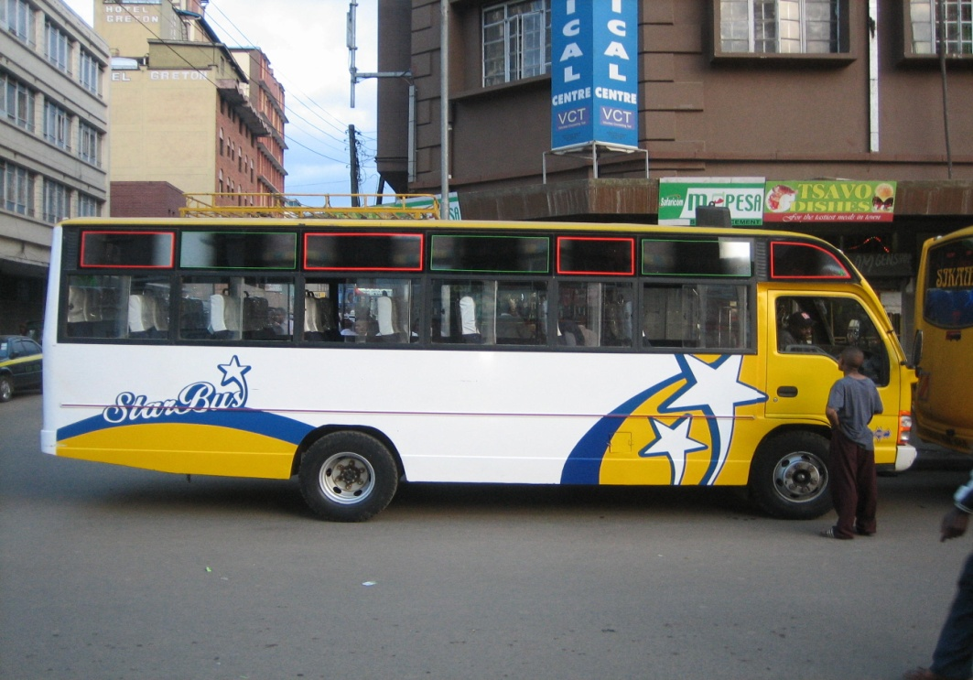
iChekiTM
A PSV/Matatu Tracking Solution
www.icheki.com [desktop]
www.icheki.xrystalgenius.com [mobile]
www.xrystalgenius.com [company]

Slide 2



What’s the problem?
?
Notes:
In most African Countries the transport system is not organised. There are no set schedules for public transport vehicles. People never know when a vehicle will arrive and so rely on chance. Insecurity levels are very high and some times people have to wake up very early to catch a psv(Matatu) risking their lives.

Slide 3



Our Solution
Rpy
Rq+LAI
☺
GPS
LAI
GPS
Notes:
Customer sends a request
We process the request Using GPS, LAI(local area identity) and Smart predictive algorithms
Return a relevant reply to customer say approximate time of arrival and current location of Vehicle
Customers give feedback(rate services, the app etc)

Slide 4






What’s cool about iCheki
Crowd provides the innovation
First commercial Kenyan Developed Android App
Notes:
We are using a multiplatform
Customers already have the monitoring devices.
Crowd sourcing
First Kenyan Developed Android App!

Slide 5
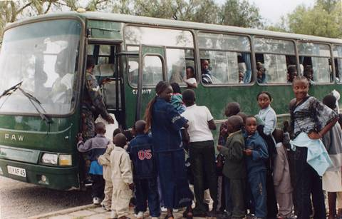


In the future(3yrs⁺⁺)
Notes:
Use GSM to track
Offer service to courier companies (For customers to Know location of their parcels in real time)
Bus booking platform
Personal tracking solutions

Slide 6
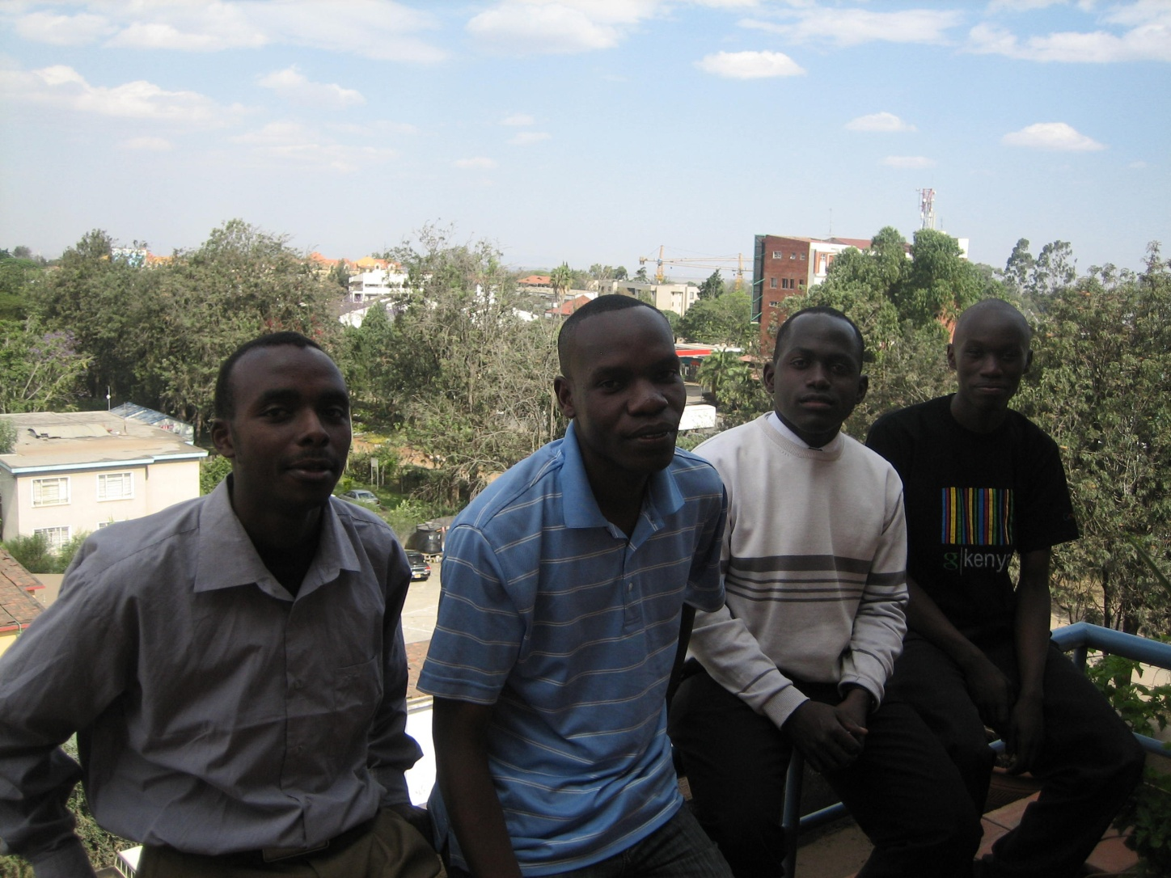
The Xrystalgenius Team
Joseph
Alex
Kelvin
Dominic

Slide 7






Thank You
*iHub_
E=mc²
$!!
Aakriti
Toan
Dan
Sam
Jessica

Slide 8
The missing link!
Ideas
iCheki
Intelligent by design
Team
Investment
Notes:
The team is ready, the ideas are plenty , the only missing piece in this jig-saw puzzle is the investment. Without the investment our idea will be far from reality.

